Slide 1
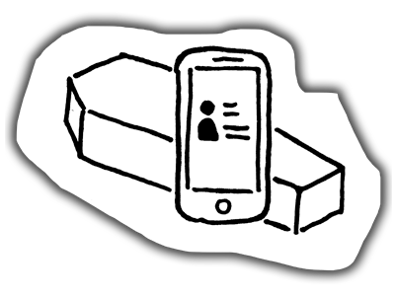
Pier 37: ID Hunters
Final Presentation
Efficient Forensic Photos

Slide 2
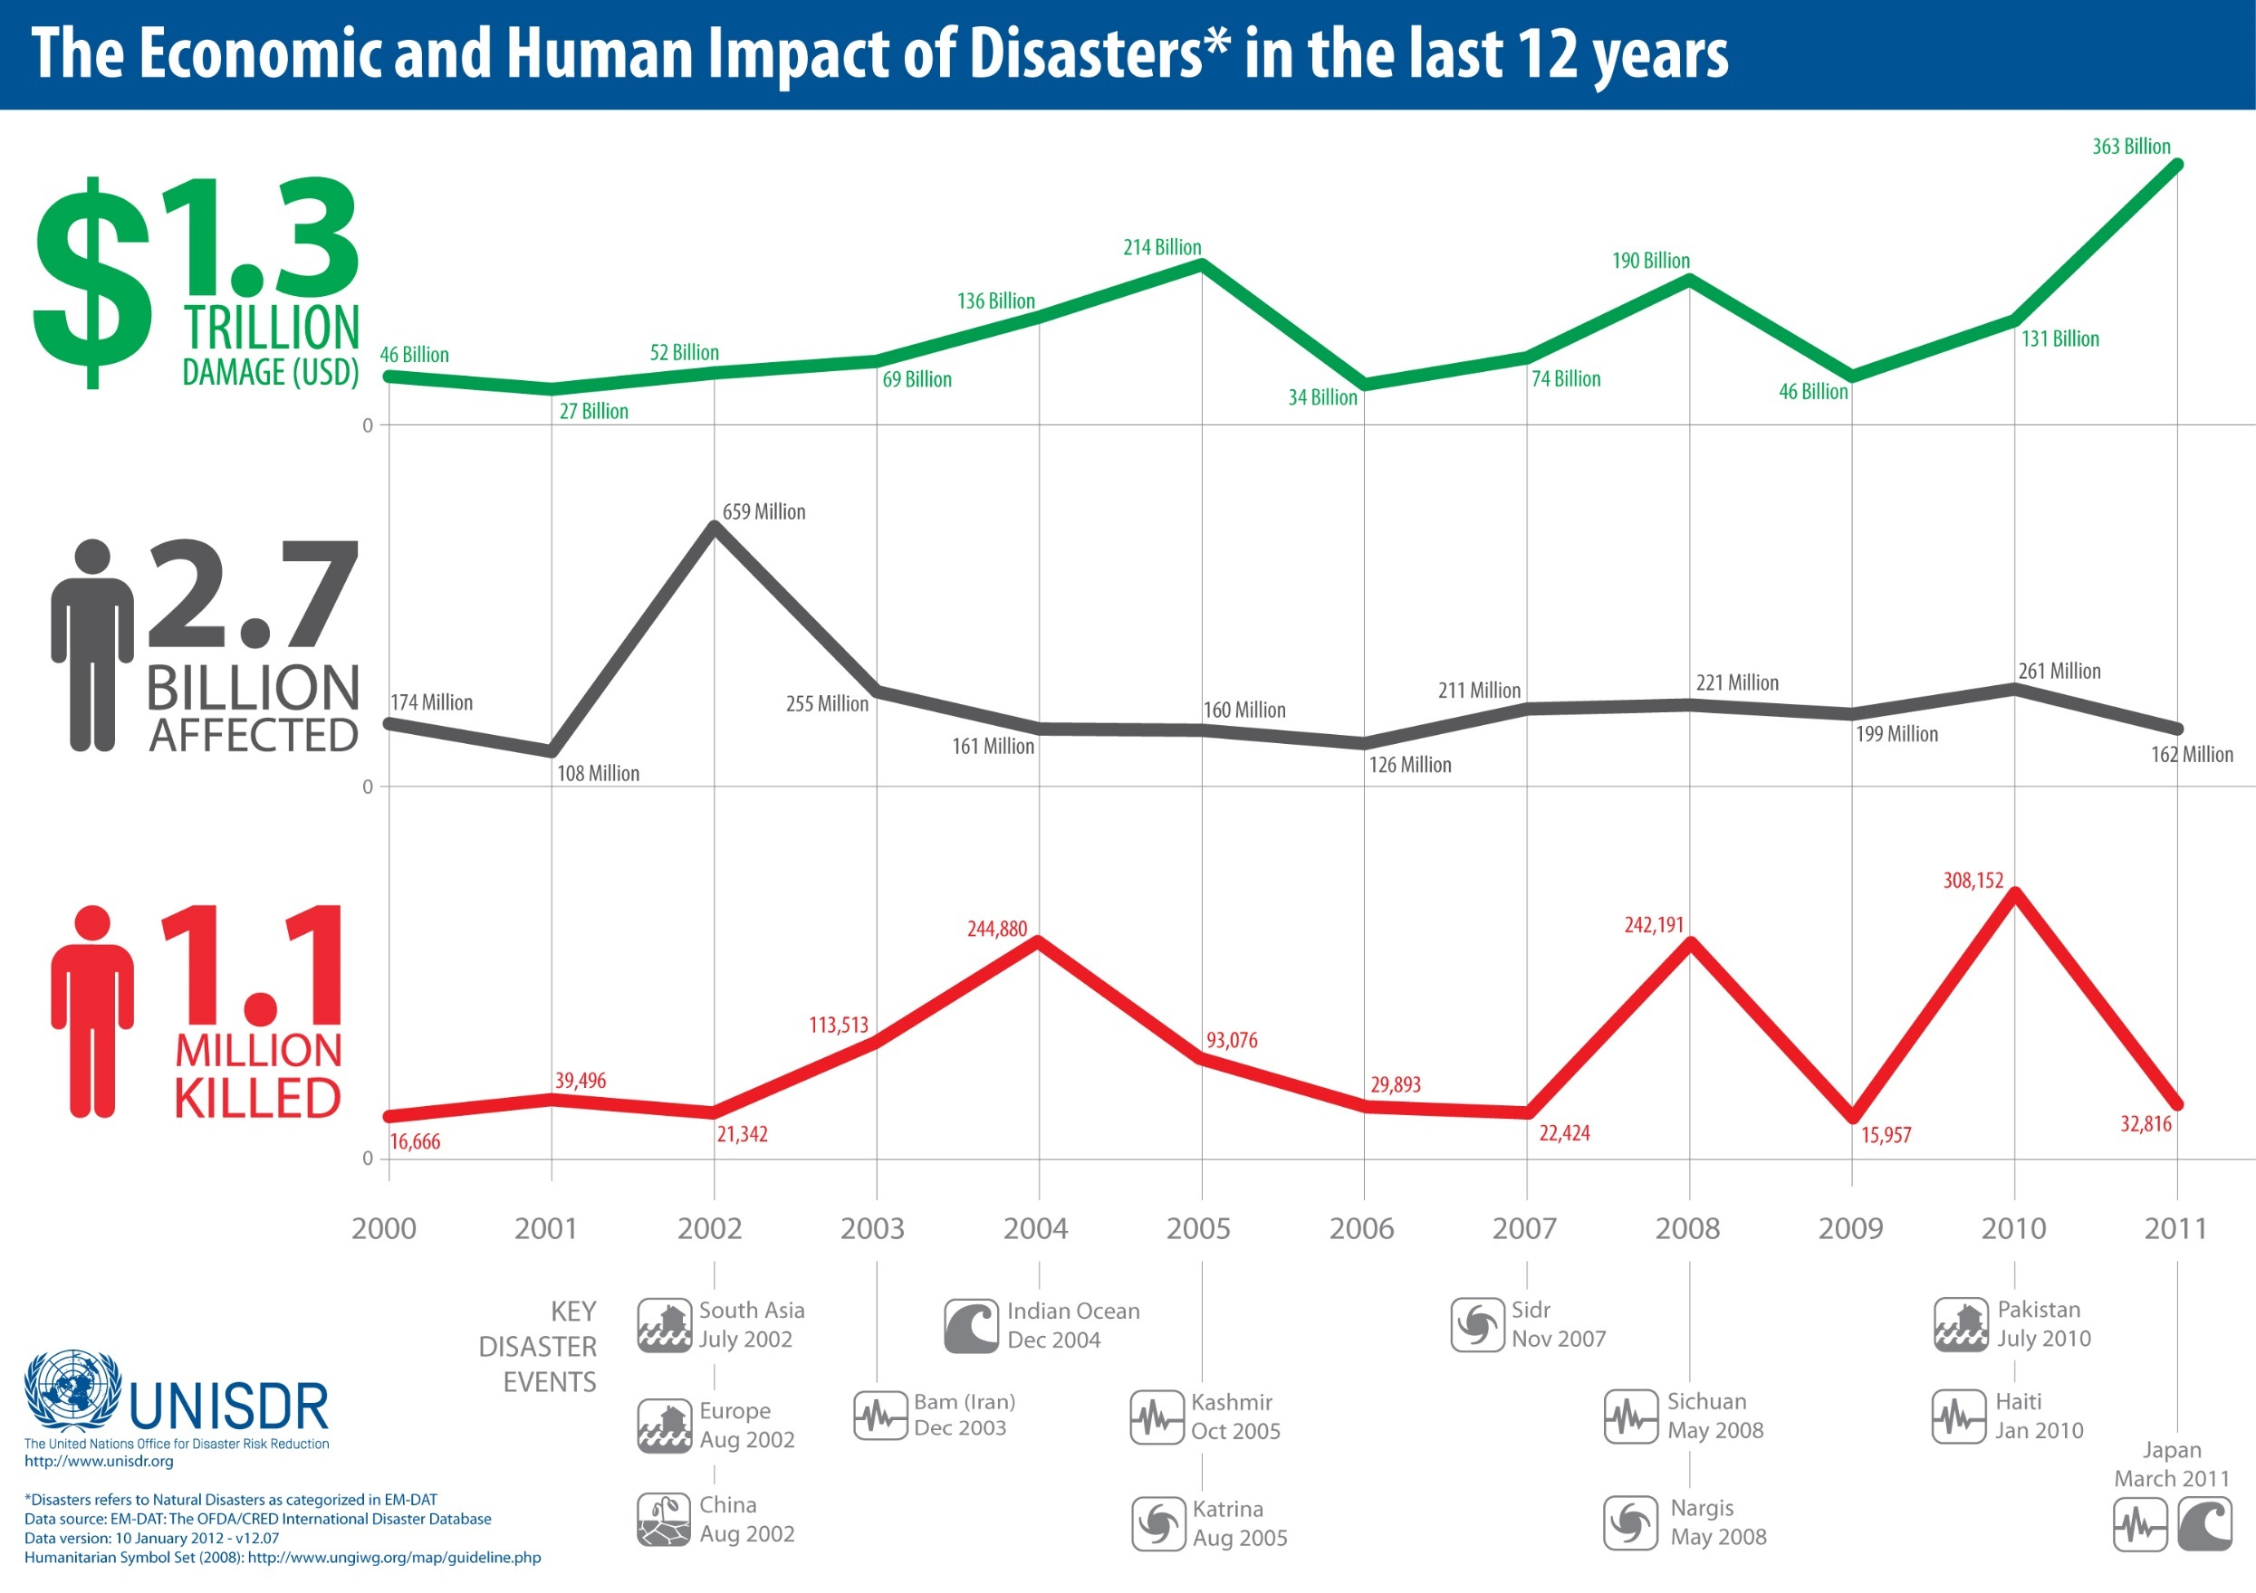
https://www.flickr.com/photos/isdr/6853316682/in/album-72157628015380393/

Slide 3

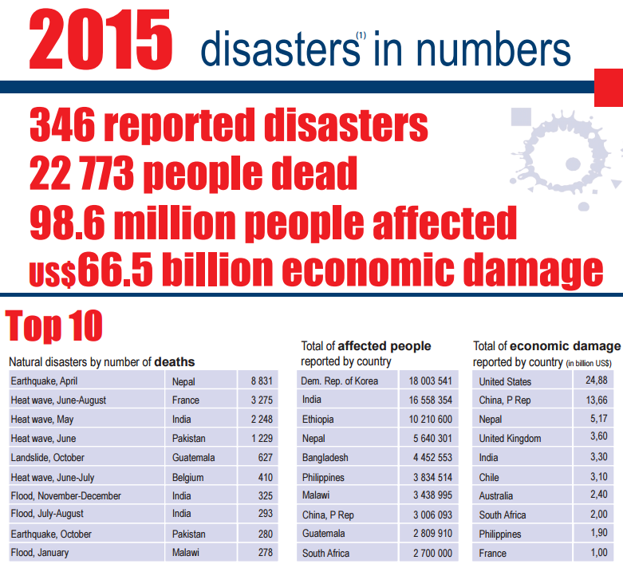
http://www.unisdr.org/files/47804_2015disastertrendsinfographic.pdf

Slide 4
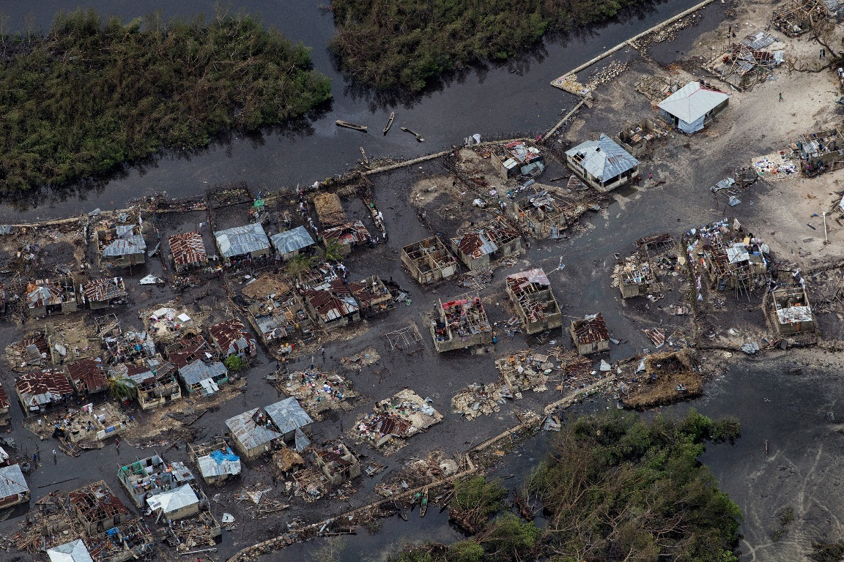
The context
Natural disasters with thousands of victims …
Aftermath of Hurricane Matthew, Haiti,
Oct 4, 2016
Portable photo studio for efficient forensic pictures

Slide 5
The importance …
Efficient forensic pictures are fundamental for
Body remains identification by family members
Automation of downstream processes

Slide 6
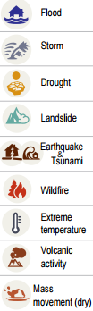
A forensic science problem …

Slide 7
The requirements
Adaptable and universal solution required
Account for different forensic environments
Inexpensive readily-available components
Improve the quality of the pictures

Slide 8
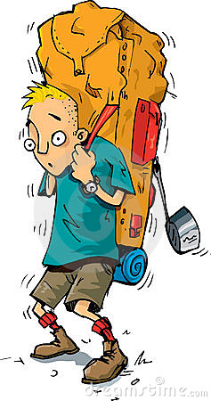
The requirements
Compact, fit in a normal size backpack

Slide 9
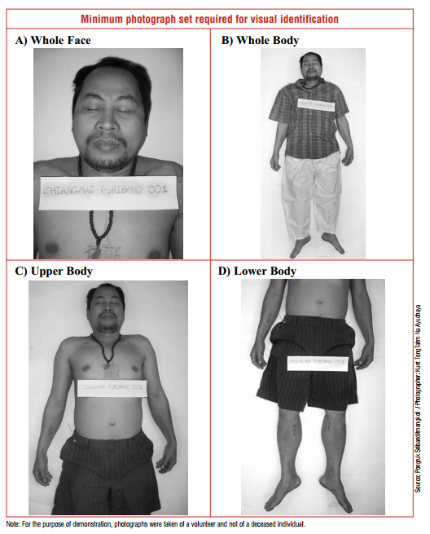
We need the following pictures:
Whole face
Whole body
Upper body
Lower body
Picture taken with the body placed on a table
Notes:
Source: https://www.icrc.org/eng/assets/files/other/icrc_002_0880.pdf

Slide 10

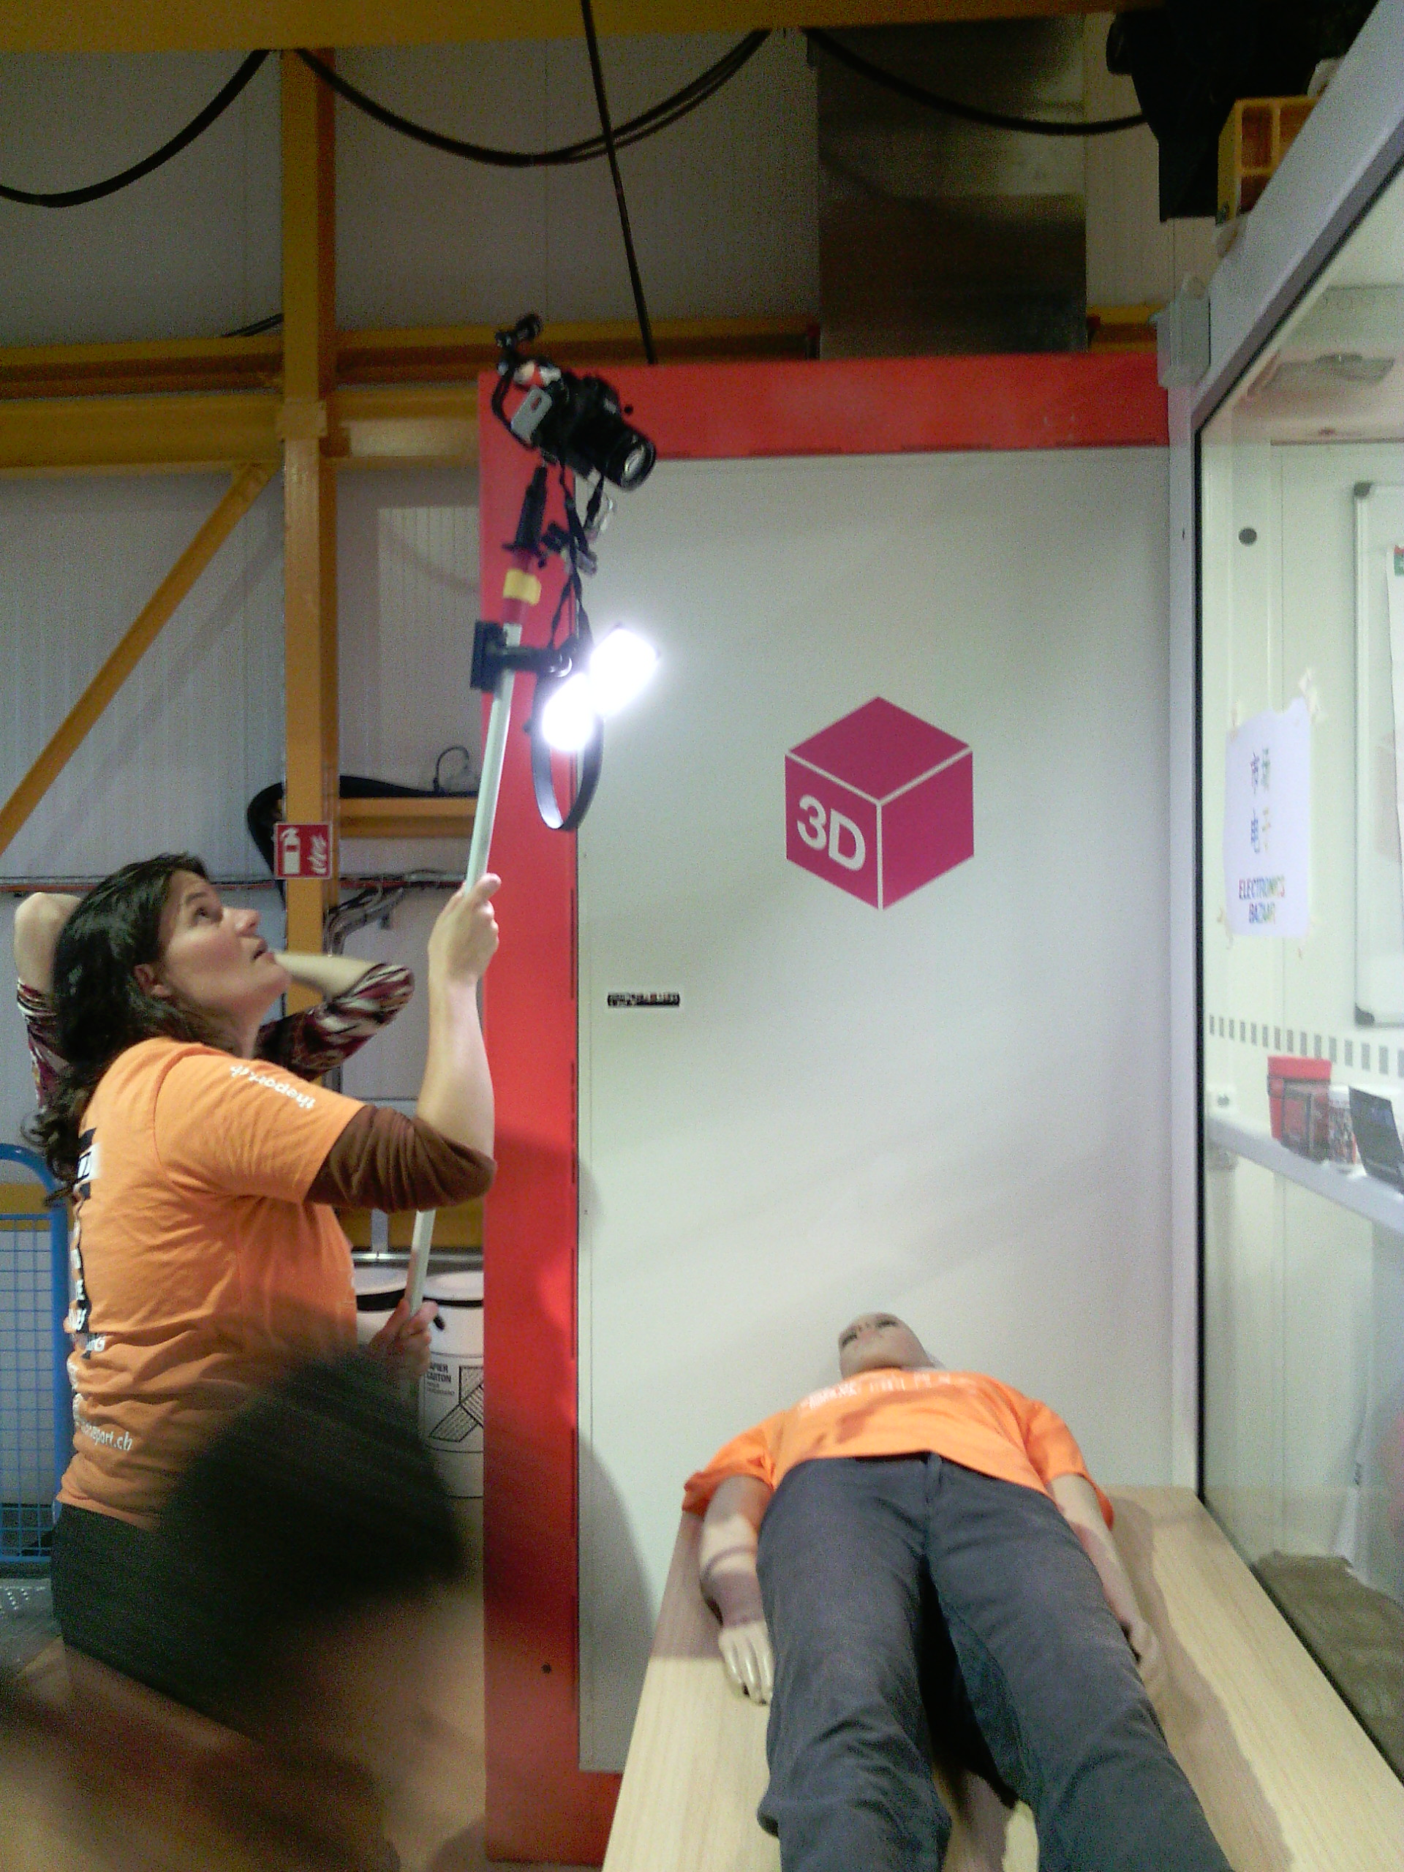
The approach
A modular “selfie” stick
Laser pointer for framing
Portable lighting
Analog trigger (?)
Post-processing (facial annotation, )

Slide 11


Laser framing
Framing using reference given by the laser
Can be used in the post-process phase to calculate dimensions

Slide 12



Analog trigger
Not all cameras have remote control, not universal
Camera is far away
We need a mechanism to trigger the camera

Slide 13
Raspberry Pi Camera for Metadata
TBD (include image)

Slide 14
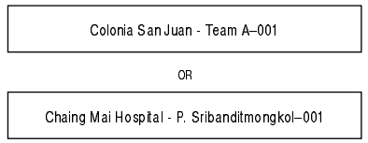

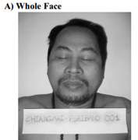
Post-Processing: Text extraction
Using Google Cloud Vision API
C:\cloud-vision\python\text>python textindex.py .\data
.\data\screenshot.png:
Colonia San Juan Team A-001
OR
Chaing Mai Hospital P. Sribanditmongkol-001
ColoniaSanJuanTeamA-001ORChaingMaiHospitalP.Sribanditmongkol-001

Slide 15
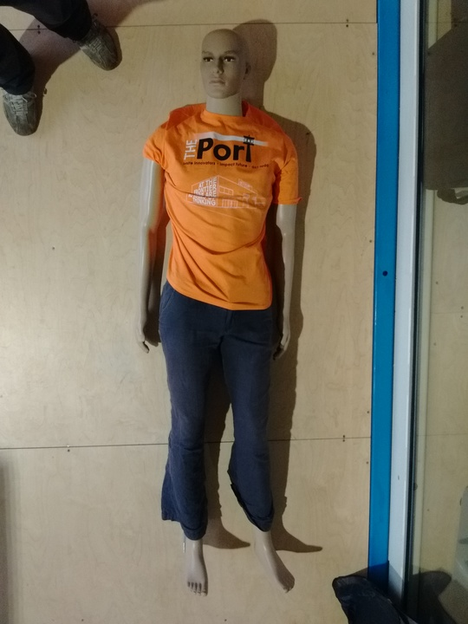
Post-Processing: Auto-annotation
Using Google Cloud Vision API
C:\cloud-vision\python\text>python label.py image.jpeg
Found label for resources\img1.jpeg:
Clothing
Male
Muscle
Toy
t shirt

Slide 16
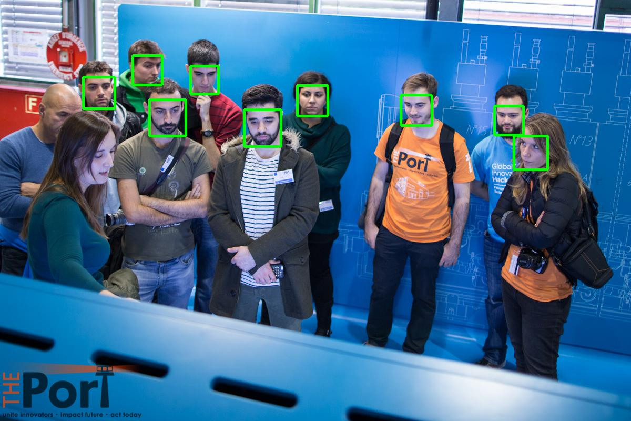
Post Processing: Face detection
Using Google Cloud Vision API
C:\cloud-vision\python\text>python faces.py image.jpg
Found 9 faces
Writing to file out.jpg

Slide 17
Things to consider …
Additional sources of identification information such as DNA, finger-printing and dental records
Auto-annotation of images with their detailed description to expedite the documentation process followed by the forensic experts
TBD

Slide 18
Thanks!

